Slide 1
Machine Learning :
101
07.12.2023

Slide 2
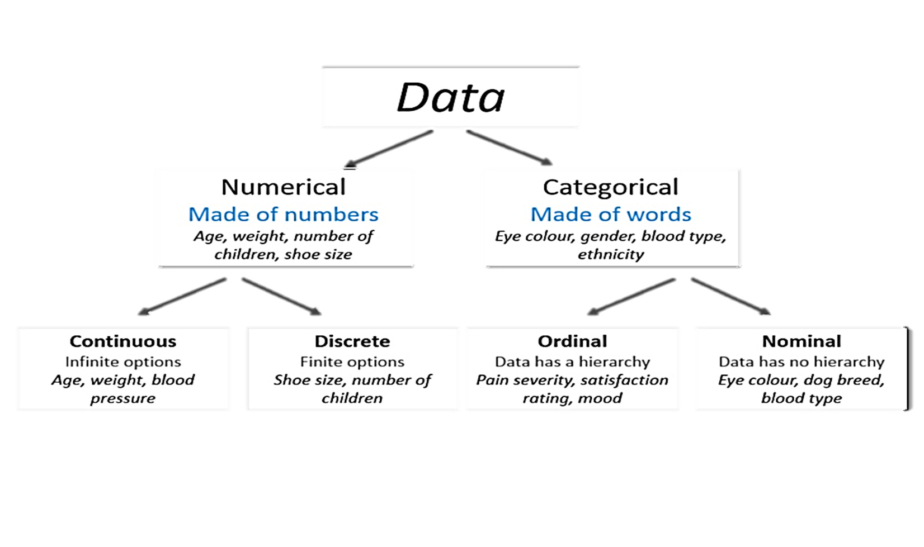
Refresher : Data Types

Slide 3
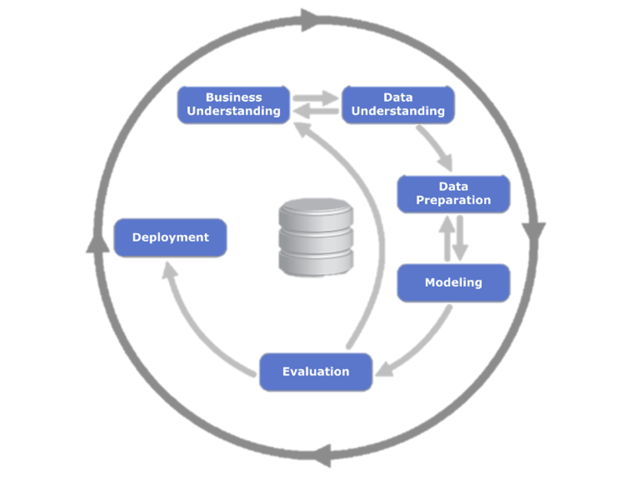
Refresher : CRISP DM

Slide 4
Refresher : CRISP DM
Business understanding: define a measurable goal. Ask: do we need ML?
Data understanding: do we have the data? Is it good?
Data preparation: transform data into a table, so we can put it into ML
Modelling: to select the best model, use the validation set
Evaluation: validate that the goal is reached
Deployment: roll out to production to all the users

Slide 5
what is Machine Learning ?

Slide 6
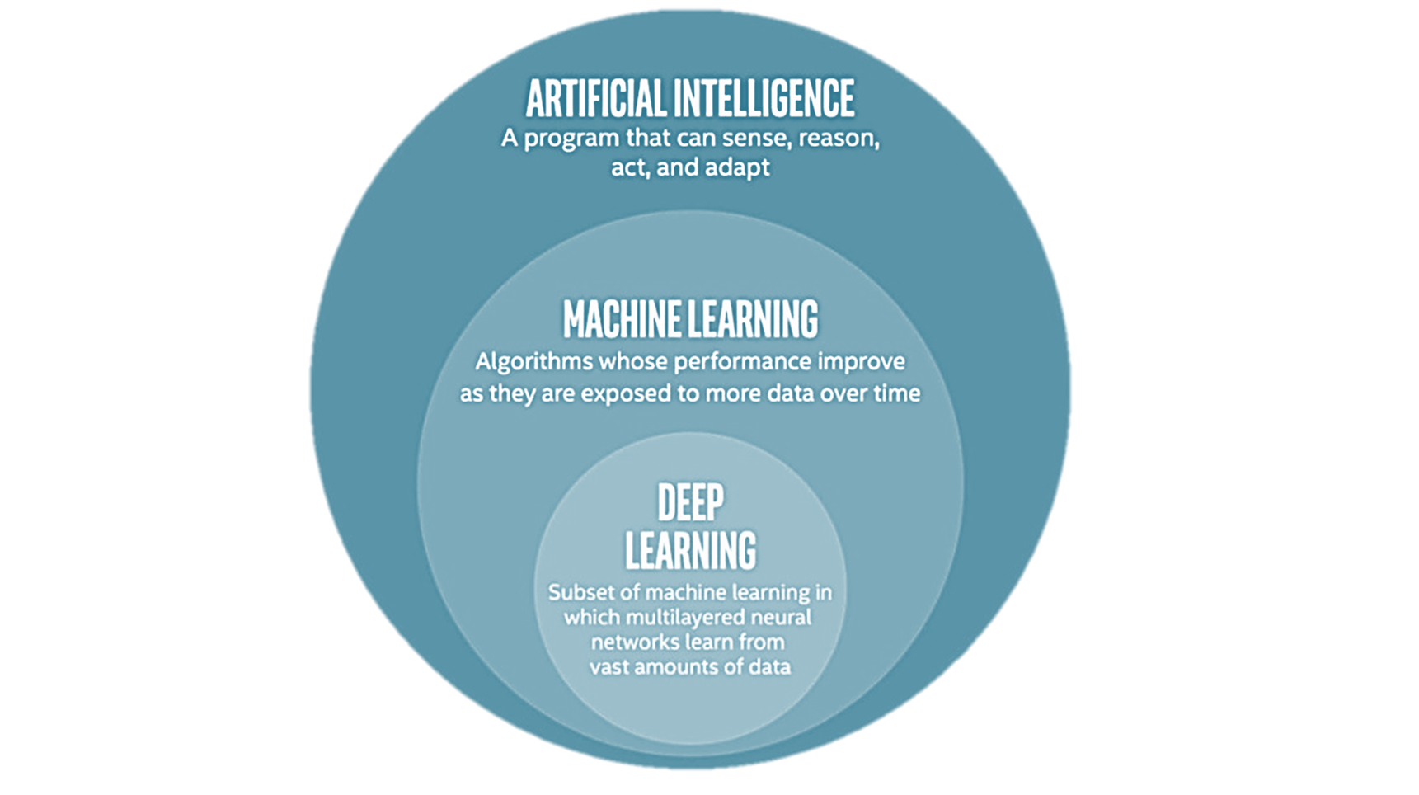

Slide 7
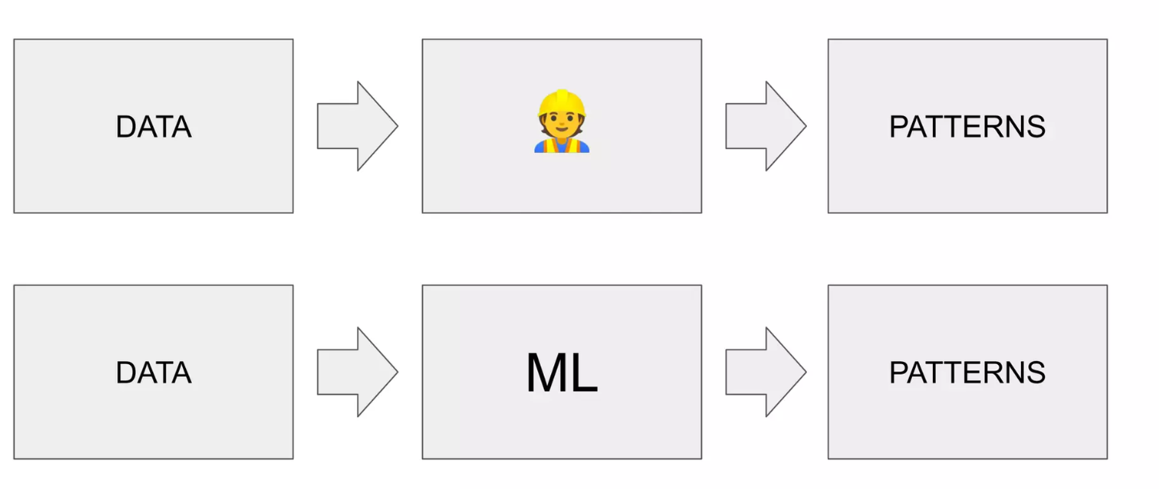

Slide 8
Machine Learning
vs
Rule Based Systems

Slide 9
Aspect | Machine Learning (ML) | Rule-Based Systems
Approach to Knowledge | Learn from data and examples, identifying patterns, relationships, and trends. | Operate on predefined rules and logic created by domain experts.
Adaptability | Adaptive; can learn from new data and generalize patterns. | Static; requires manual modification of rules for updates.
Handling Complexity | Can handle complex patterns and relationships in large datasets. | Suitable for well-defined tasks; may struggle with complexity and ambiguity.

Slide 10
Exemple : Credit Approval System
Machine Learning Approach: (UNCERTAINTY)
ML Model: Train a machine learning model using historical data on credit applicants, considering variables like income, credit score, and debt. The model learns to predict creditworthiness based on patterns in the data.
Adaptability: The model can adapt to changing economic conditions and learn from new data to refine its predictions.
Rule-Based System Approach: (DETERMINISM)
Rules: Define explicit rules for credit approval based on income thresholds, credit score ranges, and debt levels. If an applicant meets the predefined criteria, they are approved; otherwise, they are rejected.
Adaptability: If there are changes in lending regulations or if new factors become relevant (not covered by existing rules), the rules need manual modification.

Slide 11
Machine Learning Typology

Slide 12
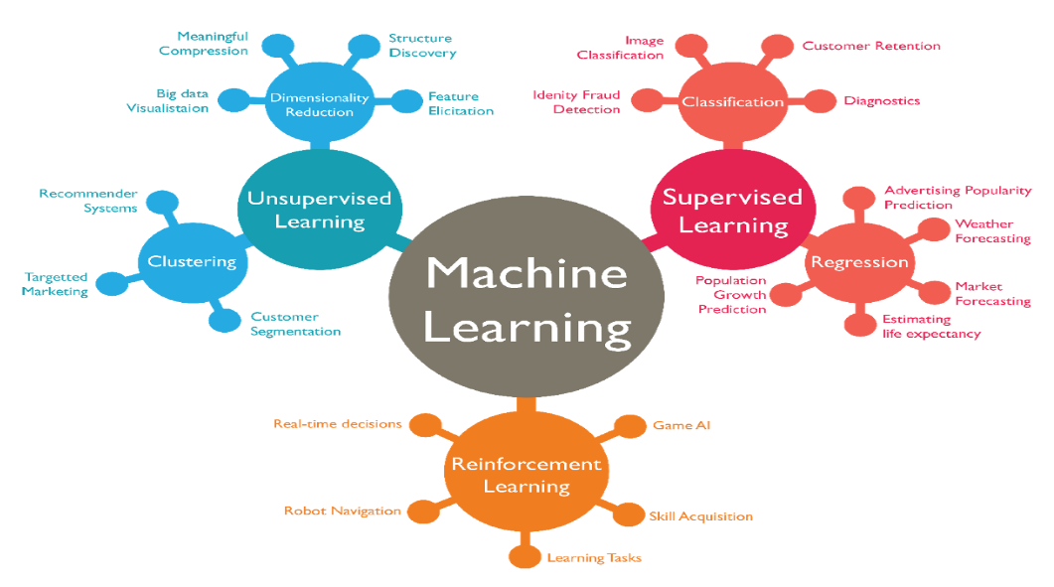

Slide 13
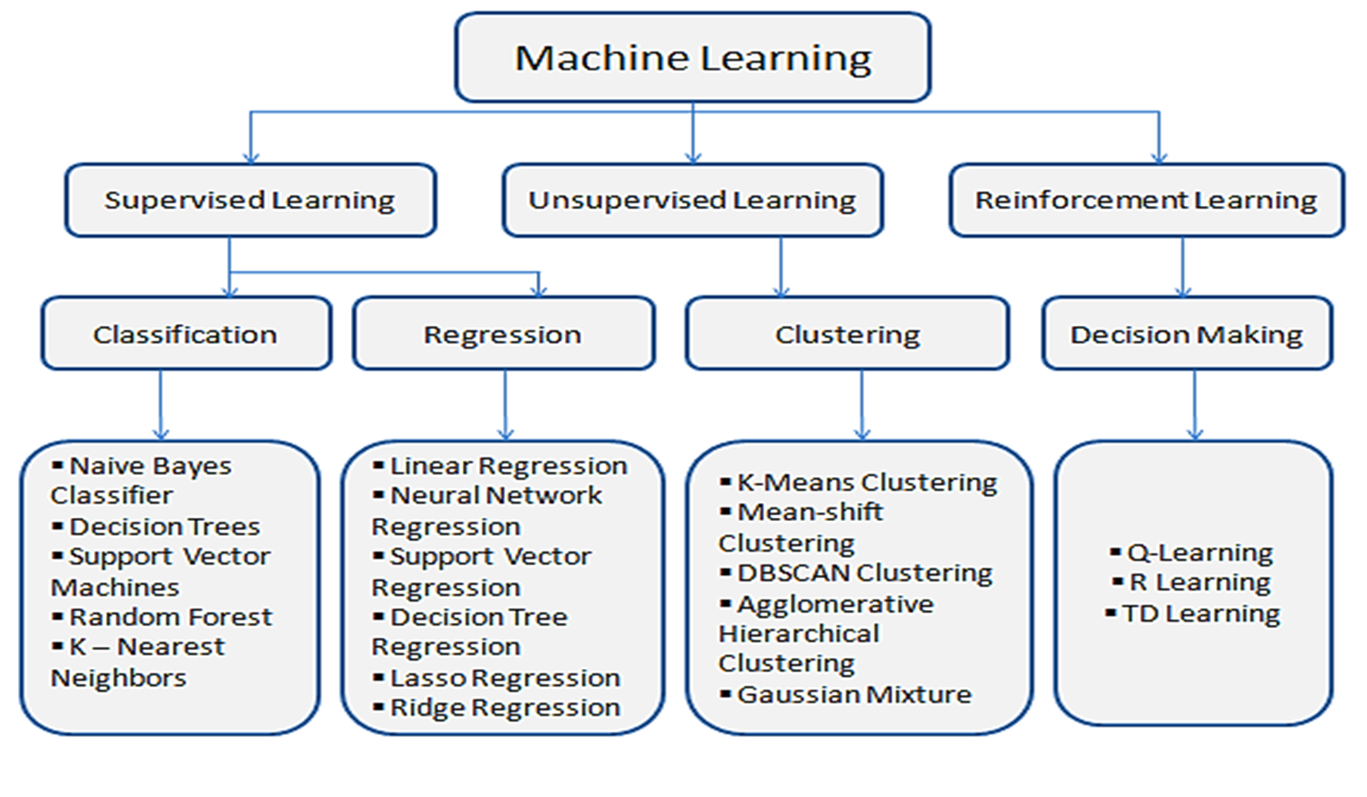

Slide 14
Supervised Learning Framework

Slide 15
Model Selection:
Choose a suitable machine learning algorithm based on the problem type (classification, regression, clustering, etc.).
Consider trying multiple algorithms to find the best fit.
Model Training:
Train the selected model on the training data.
Optimize model parameters through techniques like cross-validation.
Model Evaluation:
Assess the model's performance on a separate validation set.
Use appropriate metrics to evaluate performance (accuracy, precision, recall, etc.).
Model Tuning:
Fine-tune the model based on validation results.
Adjust hyperparameters to improve performance.
Model Testing:
Assess the final model on a separate test set to simulate real-world performance.
Ensure the model generalizes well to new, unseen data.

Slide 16
Model selection :

Slide 17
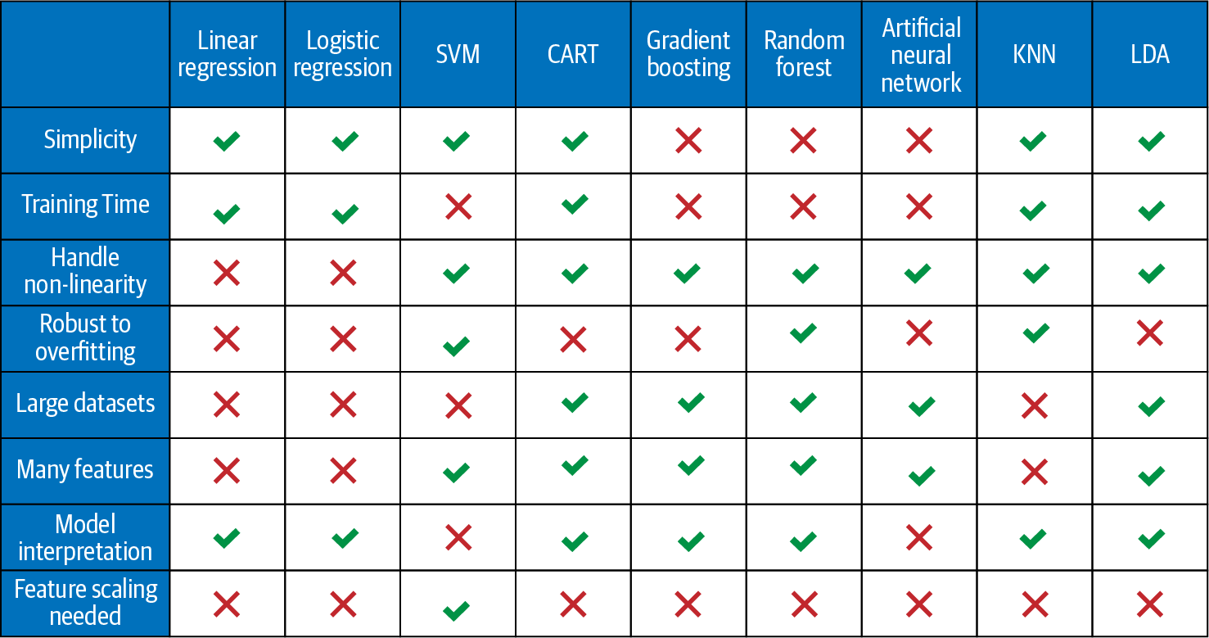

Slide 18
Model training
&
Prediction
Notes:
Features means what we know about an object. A feature is a characteristic of an object in form of a number, string, or other more complex form
Target is what we want to predict. That means, in training, you talk about a labeled data set because you know the target.
Model is the output artefact of a training that contains all the patterns learned from the trained examples. This output can be used later to make a prediction (try to output the target variable) based on features of an unknown object and the model itself.

Slide 19
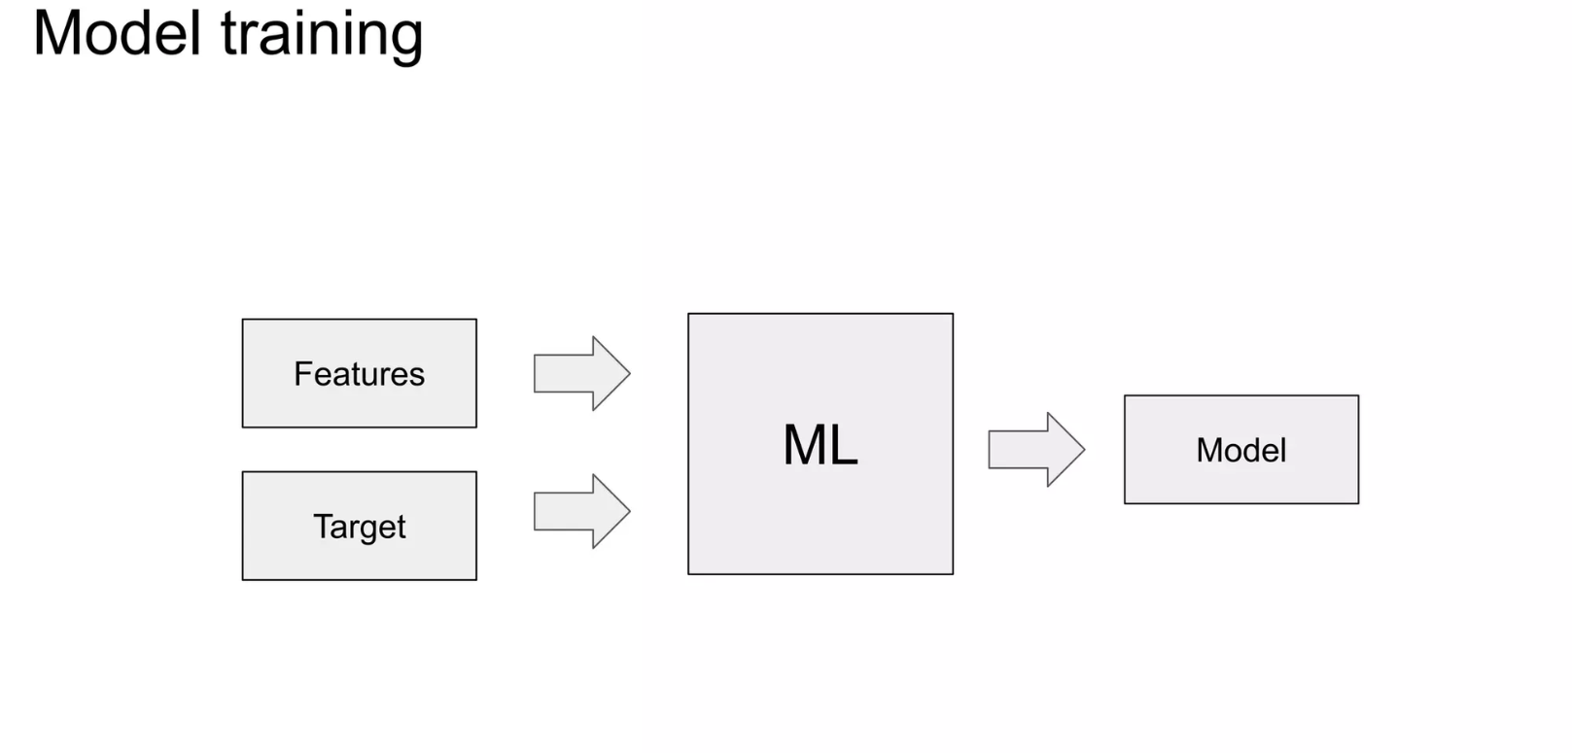
Model Training :

Slide 20
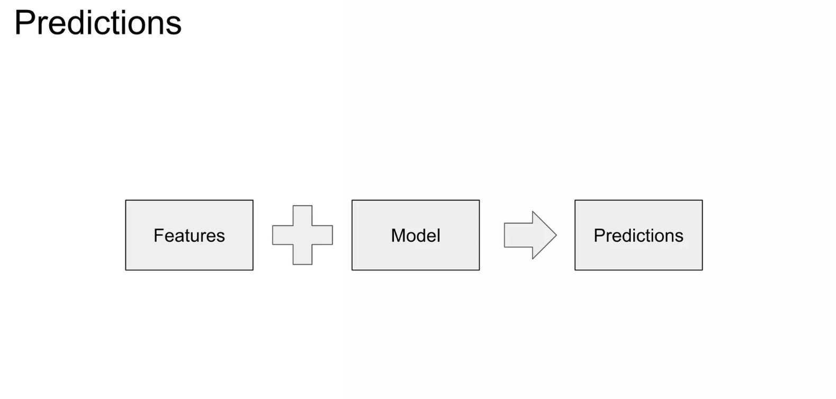
Predictions :

Slide 21
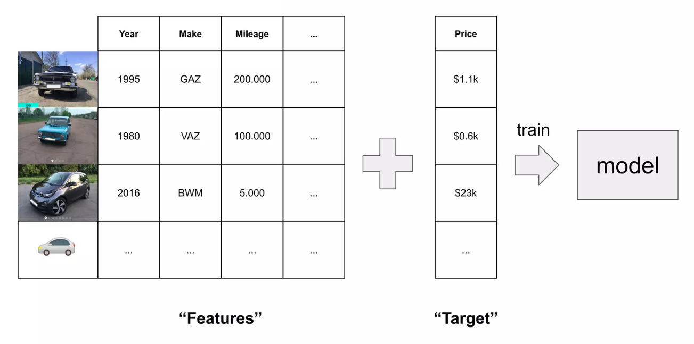

Slide 22
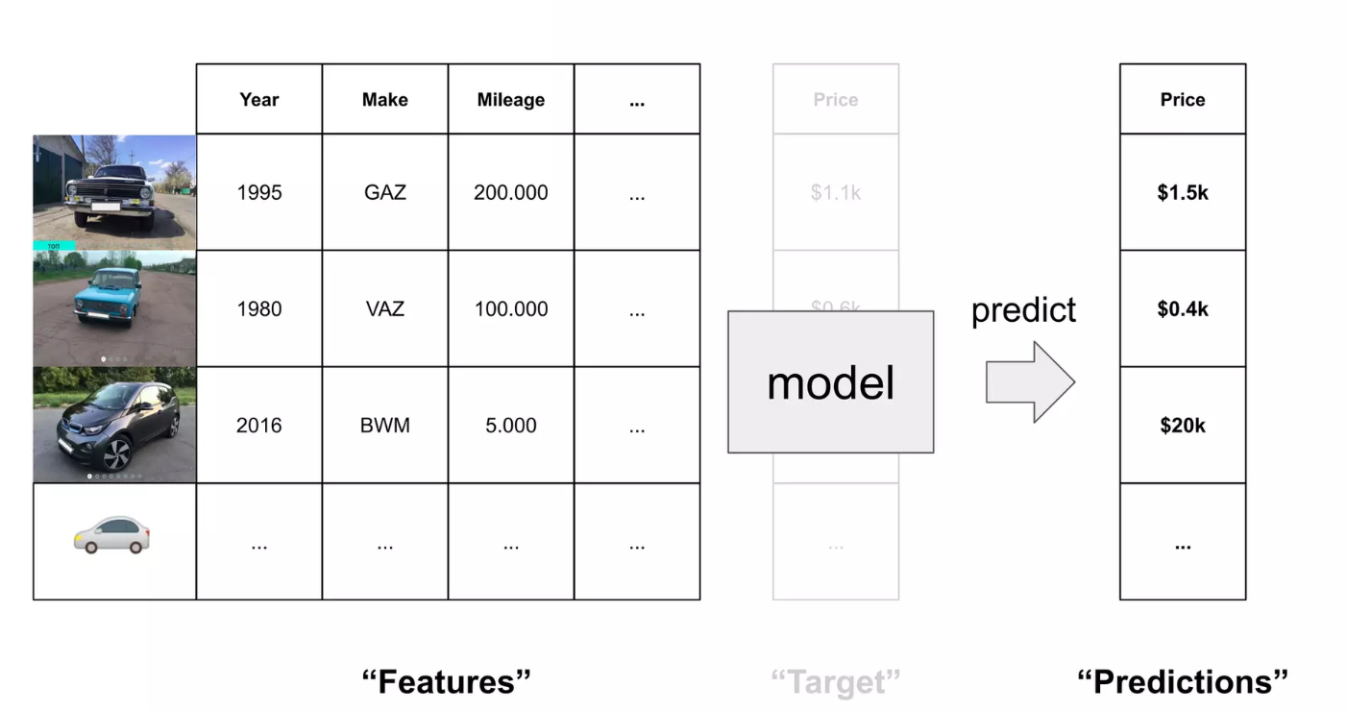

Slide 23
Model : Regression

Slide 24
Regression is a statistical technique used in machine learning and statistics to model the relationship between a dependent variable and one or more independent variables. The goal of regression analysis is to understand the nature of the relationship between the variables, make predictions, and infer the impact of changes in the independent variables on the dependent variable.
Geometric POV :
The process of regression involves finding the best-fitting line (or curve) that minimizes the difference between the predicted values and the actual values. This is often done using optimization techniques

Slide 25
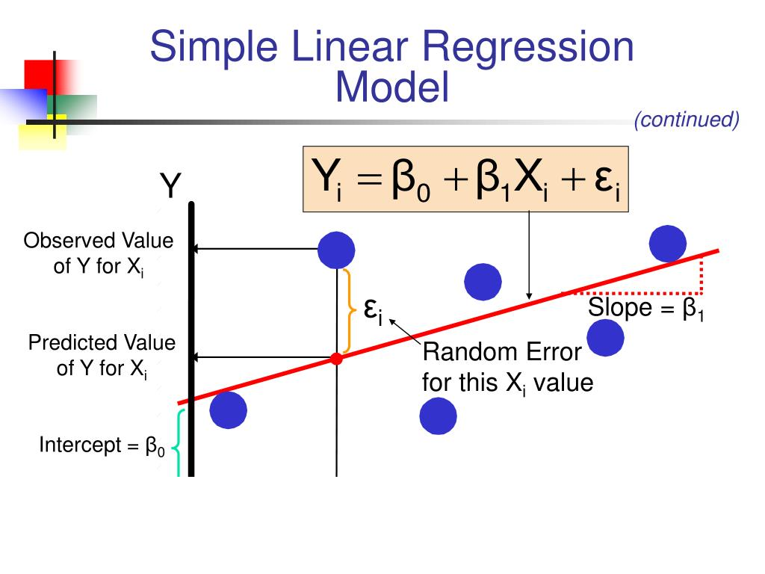
Linear Regression Model

Slide 26
Project:
House Price Detection in California

Slide 27
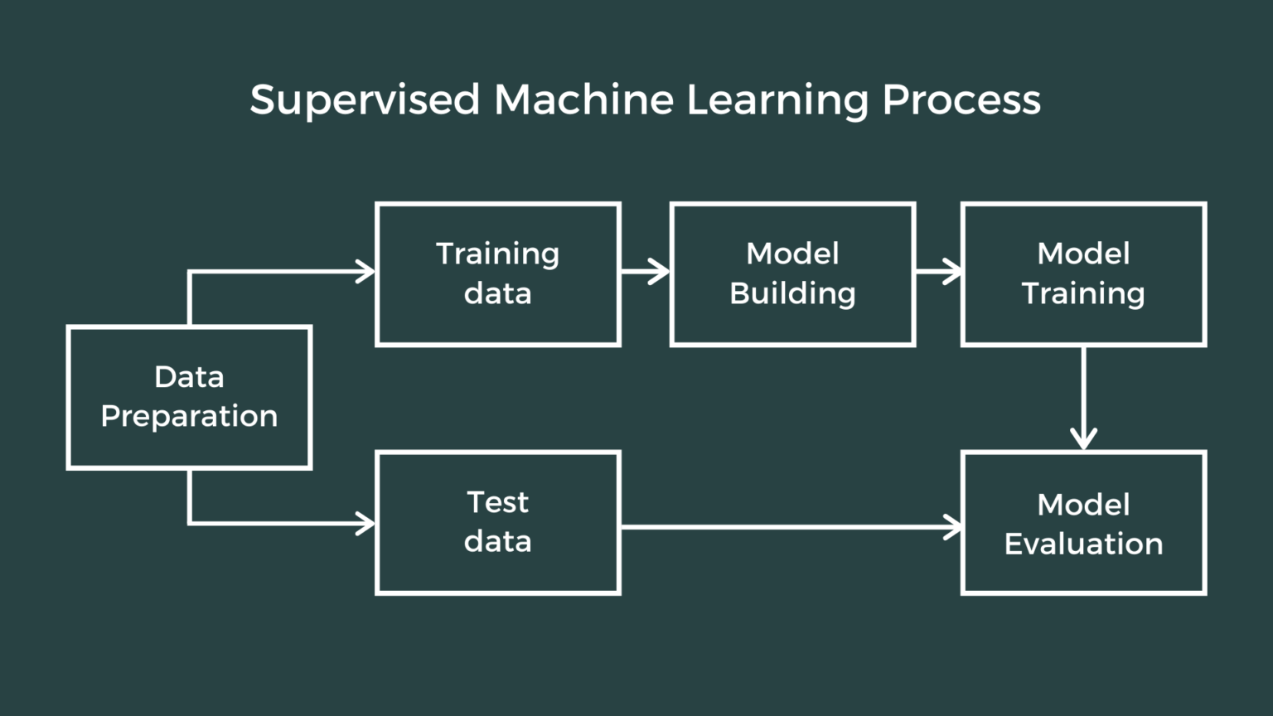

Slide 28
Model Evaluation :

Slide 29
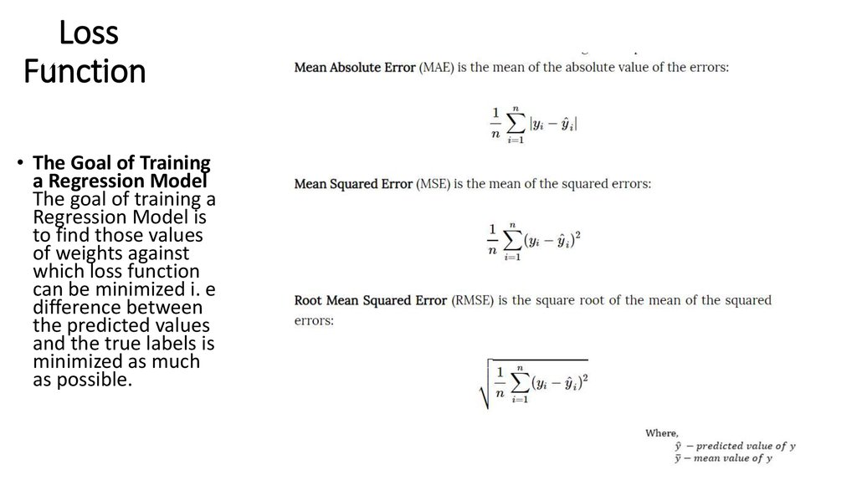
Evaluation Metrics
Notes:
Inspiration: https://towardsdatascience.com/evaluation-metrics-model-selection-in-linear-regression-73c7573208be

Slide 30
Evaluation Metrics Interpretation
Mean Absolute Error (MAE):
Interpretation: MAE represents the average of the absolute differences between predicted and actual values. It provides a direct measure of the average magnitude of errors, regardless of their direction (overestimation or underestimation).
Sensitivity: MAE is less sensitive to outliers compared to MSE and RMSE because errors are summed without squaring.
Mean Squared Error (MSE):
Interpretation: MSE measures the average of the squared differences between predicted and actual values. It penalizes larger errors more heavily due to the squaring operation.
Sensitivity: MSE is sensitive to outliers as larger errors contribute disproportionately to the overall value due to squaring.

Slide 31
Thank You For Your Attention

Slide 32
Notes
Problématique : “un marocain qui ne sait rien de la langue chinoise et veut l’apprendre “
Apprentissage Supervisé :
Analogie : Imaginez que le Marocain a un tuteur chinois qui lui enseigne la langue. Le tuteur lui montre des exemples de phrases en chinois et lui dit comment les prononcer et les utiliser correctement.
Parallèle avec ML : L'apprentissage supervisé en ML consiste à entraîner un modèle sur un ensemble de données étiquetées, où le modèle apprend à faire des prédictions en se basant sur des exemples avec des étiquettes associées.
Apprentissage Non Supervisé :
Analogie : Le Marocain explore la Chine sans guide ni instruction spécifique. Il essaie de découvrir des schémas et des similitudes par lui-même en observant la langue, les coutumes, et l'environnement chinois.
Parallèle avec ML : L'apprentissage non supervisé en ML implique la découverte de structures intrinsèques dans les données sans étiquettes. Cela peut inclure la segmentation de données similaires, la détection de motifs, etc., sans la présence d'étiquettes explicites.
Apprentissage Renforcé :
Analogie : Le Marocain apprend le chinois en interagissant avec les locuteurs natifs et en ajustant son langage en fonction des réponses qu'il reçoit. Les erreurs et les succès sont utilisés pour affiner sa compréhension de la langue.
Parallèle avec ML : L'apprentissage renforcé en ML implique un agent qui prend des actions dans un environnement et reçoit des récompenses ou des sanctions en fonction de la qualité de ces actions. L'agent ajuste son comportement pour maximiser les récompenses au fil du temps.

Slide 33
Notes
g(X) = Y
g : model
X : Features
Y : Target
Y^ : Prediction
Features means what we know about an object. A feature is a characteristic of an object in form of a number, string, or other more complex form
Target is what we want to predict. That means, in training, you talk about a labeled data set because you know the target.
Model is the output artefact of a training that contains all the patterns learned from the trained examples. This output can be used later to make a prediction (try to output the target variable) based on features of an unknown object and the model itself.

Slide 34
Notes
step 1: 60% -20% -20% ( TrainingSet , ValidationSet ,TestSet) (SPLIT)
step 2: evaluating performance and comparing ( in the end we choose which model to adopt among many )
step 3: 80% -20% (TS+VS , TeS)
step 4: Testing and final check ( for only the model we chose previously )
Split datasets in training, validation, and test. E.g. 60%, 20% and 20% respectively
Train the models
Evaluate the models
Select the best model
Apply the best model to the test dataset
Compare the performance metrics of validation and test

